Slide 1
Chapter Five
Verification and Validation
of Simulation Models

Slide 2
VERIFICATION AND VALIDATION OF SIMULATION MODELS
One of the most important and difficult tasks facing a model developer is verification and validation of simulation model.
It is the job of the model developer to work closely with the end users throughout the period (development and validation).
The Goal of the validation process is two fold.
To develop a better model.
To increase the credibility of the model, so that the model will be used by managers and other decision makers.

Slide 3
VERIFICATION AND VALIDATION OF SIMULATION MODELS
Validation and verification are two of the most important steps in any simulation project.
Validation is the process of determining the developed model is an accurate representation of the actual system being analyzed.
Verification:- It is utilized in comparison of the conceptual model to the computer representation. (i.e. debugging the computer program).
It asks the questions:
Is the conceptual model implemented correctly in the computer?
Are the input parameters and logical structure of the model correctly represented?

Slide 4
Model Building, Verification and Validation
The first step in model building consists of
Observing the real system , the interactions among its various components and collecting data on its behavior.
The second step is building a conceptual model based on
The assumptions on system components or structure.
hypothesis on the values of model input parameters.
The third step is the translation of the conceptual model into operational model (computer recognizable form).

Slide 5
Verification of Simulation Models
The purpose of model verification is to assure the conceptual model is reflected accurately in the computerized representation.
The conceptual model involves some degree of abstraction about system operations or some amount of simplification of actual operations.
Suggestions in the verification process
Have someone else check the model.
Make a flow diagram that includes each logically possible interaction of a system.
Closely examine the model output for reasonableness under a variety of input parameter settings.
Print the input parameters at the end of the simulation.
Make the computerized representation of self-documenting as possible.
Check the animation imitates the real system.
Graphical interfaces are recommended for accomplishing verification & validation.

Slide 6
Calibration and Validation of Models
Validation: the overall process of comparing the model and its behavior to the real system.
Calibration: the iterative process of comparing the model to the real system and making adjustments. Validation is achieved through calibration.
The comparison of the model to reality is carried out by variety of test. These are subjective and objective.
Subjective test usually involve people, who are knowledgeable about one or more aspects of the system, making judgments about the model and its output.
Objective tests always require data on the system's behavior plus the corresponding data produced by the model.

Slide 7
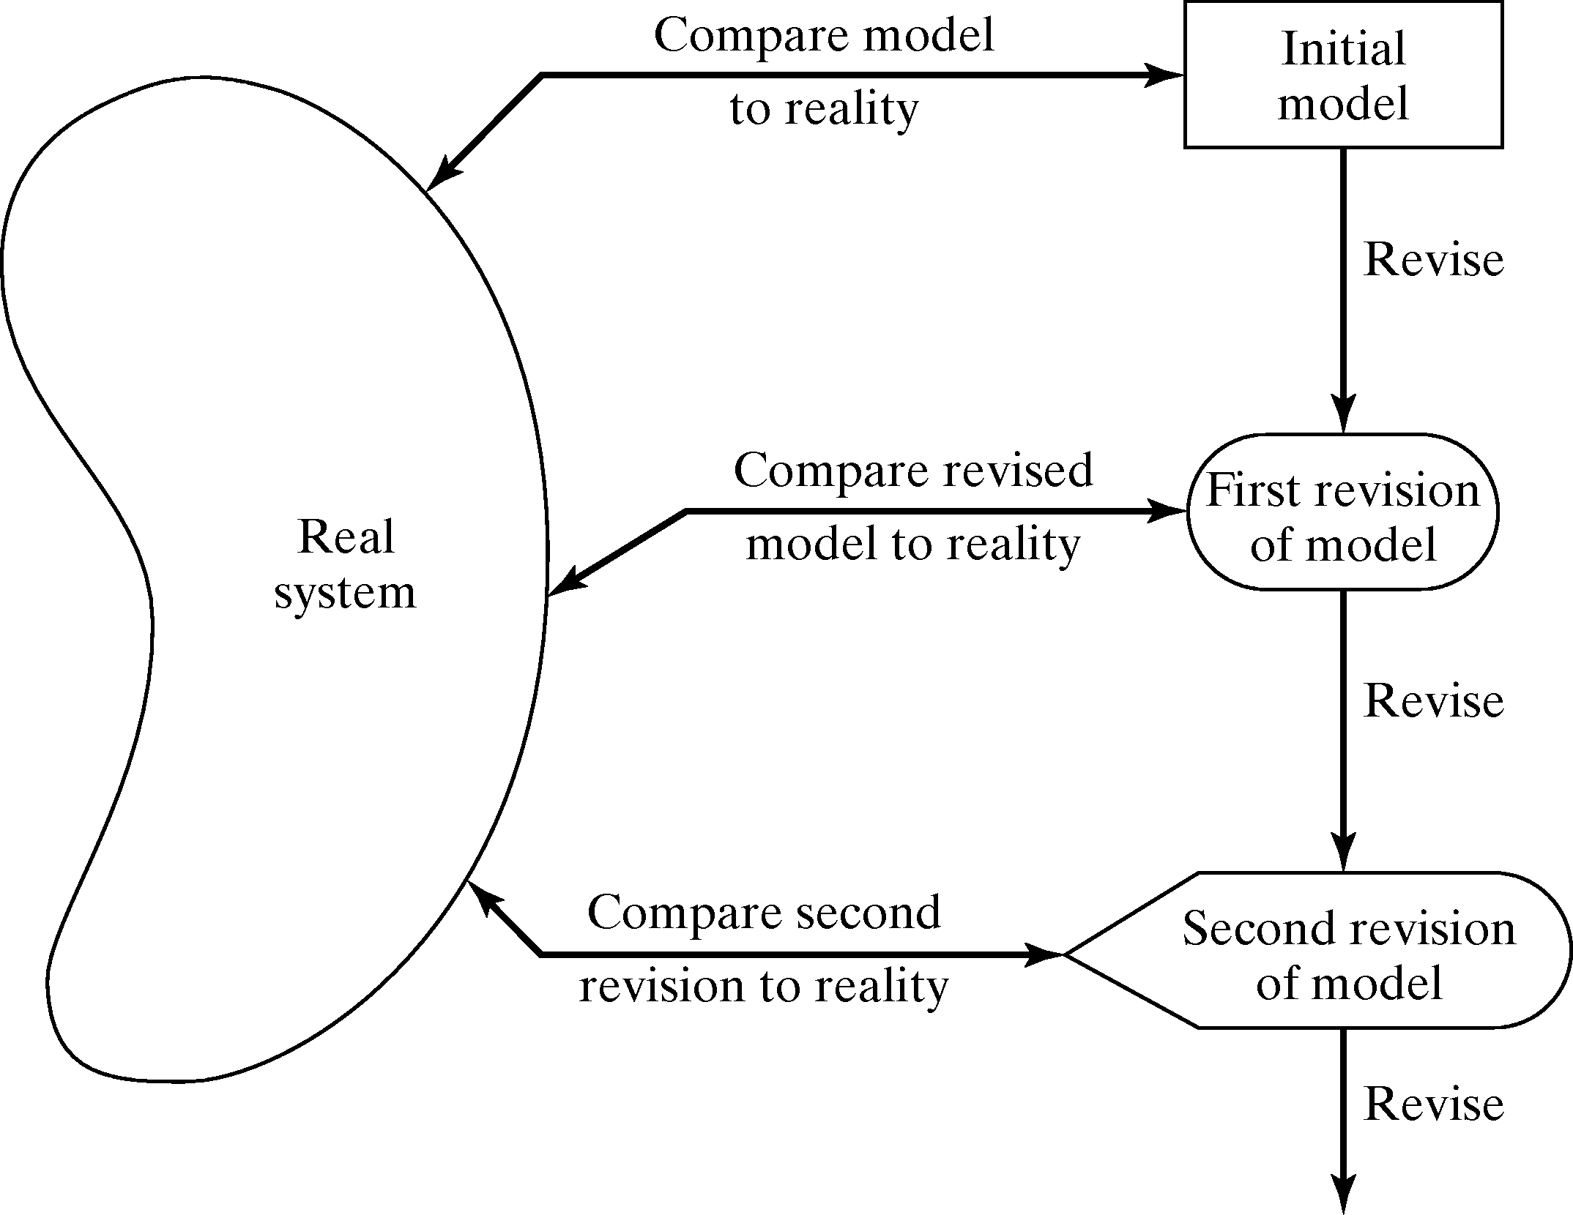
Figure-5.2: Iterative Process of Calibration model

Slide 8
Calibration and Validation
No model is a perfect representation of the system.
Three step of validation approach by Naylor and Finger [1967] .
Build a model that has high face validity.
Validate model assumptions.
Compare the model input-output transformations to corresponding input-output transformations for the real system.

Slide 9
FACE VALIDITY
The developed model appears reasonable on its face to model users and others who are knowledgeable about the real system being simulated.
To ensure a high degree of realism potential users should be involved in model development (from its conceptualization to its implementation).
Based on experience and observations on the real system the model user and model builder can know the direction of change in model output when an input variable is increased or decreased.

Slide 10
Validation of Model Assumptions
General classes of model assumptions:
Structural assumptions:- This assumption involves question, how the system operates and usually involve simplification and abstractions of reality.
Data assumptions:- This assumption is based on the collection of reliable data and correct statistical analysis of the data.
Example interarrival time of customers, service times for commercial accounts.

Slide 11
Validating I-O Transformations
The model accepts the values of input parameters and transforms these inputs into output measure of performance.
If the system is in planning stage and no system operating data can be collected, complete input-output validation is not possible.
Validation increases modeler’s confidence that the model of existing system is accurate.
Changes in the computerized representation of the system, ranging from relatively minor to relatively major.

Slide 12
THANK YOU ?

